Slide 1

Part iv project seminar
Project #116 how much slack is in a multiprocessor schedule?

Slide 2
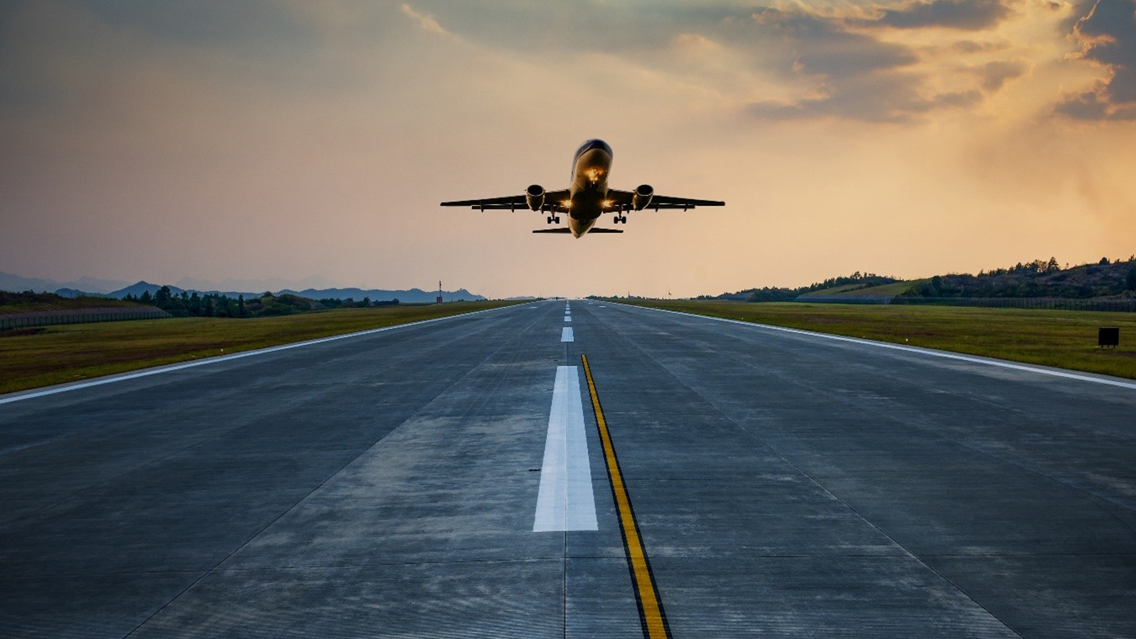
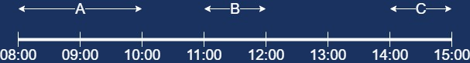
Schedule
Flight | Departure | Arrival
A | 08:00 | 10:00
B | 11:00 | 12:00
C | 14:00 | 15:00
Presenter : Harrison Warahi

Slide 3

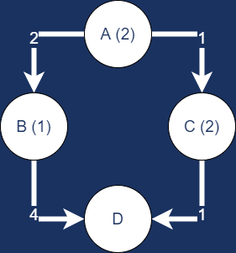
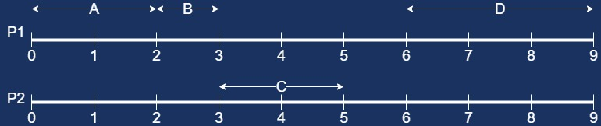
Task scheduling in multiprocessors
Presenter : Harrison Warahi

Slide 4
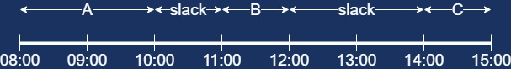
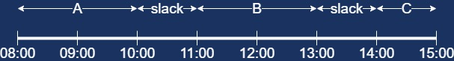
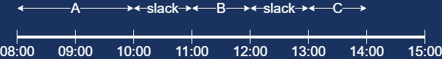
What is slack?
Presenter : Harrison Warahi

Slide 5
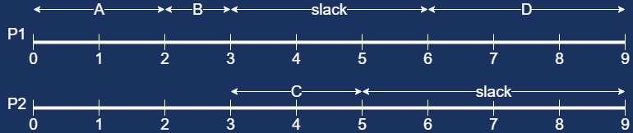
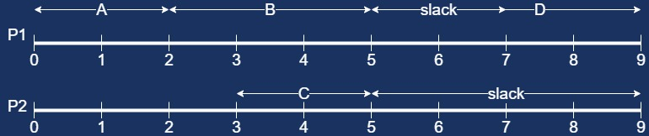
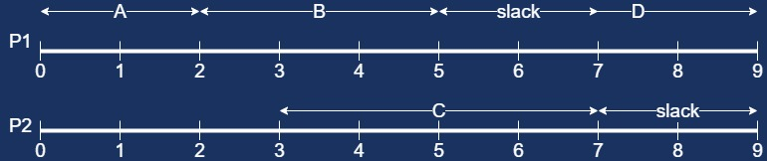
Slack in a multiprocessor schedule
Presenter : Harrison Warahi

Slide 6

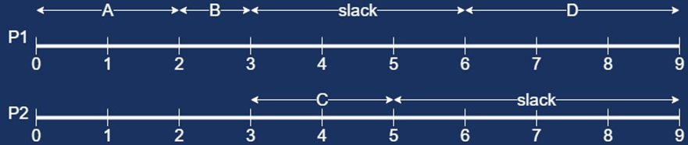

Slack reclamation techniques in the reviewed literature
Dynamic voltage/frequency scaling
Presenter : Harrison Warahi

Slide 7
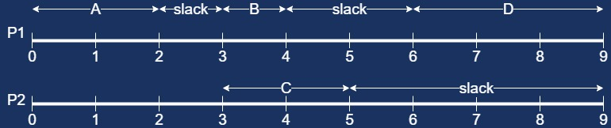

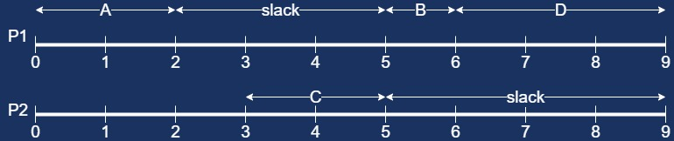
Slack reclamation techniques in the reviewed literature
Procrastination scheduling
Presenter : Harrison Warahi

Slide 8
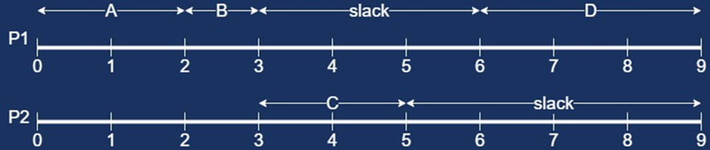

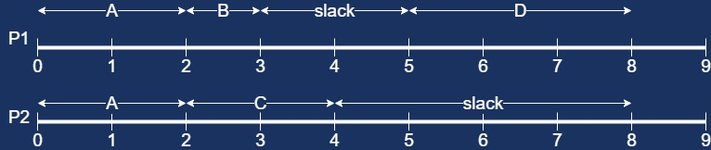
Slack reclamation techniques in the reviewed literature
Duplication based scheduling
Presenter : Harrison Warahi

Slide 9
Gaps in the current state of knowledge
The amount of slack in multiprocessor schedules
The applicability of proposed algorithms to other models
Slack as a performance metric
Presenter : Prabhnandan Singh

Slide 10



Our research intent
Analyse slack in different graphs
Analyse slack reclamation algorithms
Introduce slack as a performance metric
Presenter : Prabhnandan Singh

Slide 11



Methodology
Create a slack calculation algorithm
Analyse different graph models
Analyse slack reclamation algorithms
Compare slack reclaimed with other performance metrics
Presenter : Prabhnandan Singh

Slide 12
Example of our algorithm
Our algorithm
Slack time = 7 time units Idle time = 3 time units
Slack percentage = 38.89% Idle time percentage = 16.67%
Presenter : Prabhnandan Singh

Slide 13
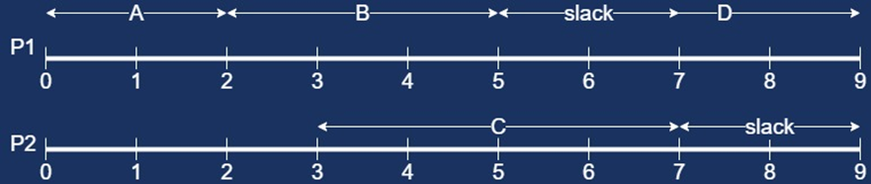
Slack reclamation analysis using our algorithm
Our algorithm
Slack time = 4 time units Idle time = 3 time units
Slack percentage = 22.22% Idle time percentage = 16.67%
Presenter : Prabhnandan Singh

Slide 14

Thank You
Harrison Warahi
Prabhnandan Singh

